Slide 1


Problem-Gap-Hook: Effective Scholarly Writing
Instructors: Drs Elif Bilgic and Anita Acai; Acknowledgment: Dr Meredith Vanstone

Slide 2
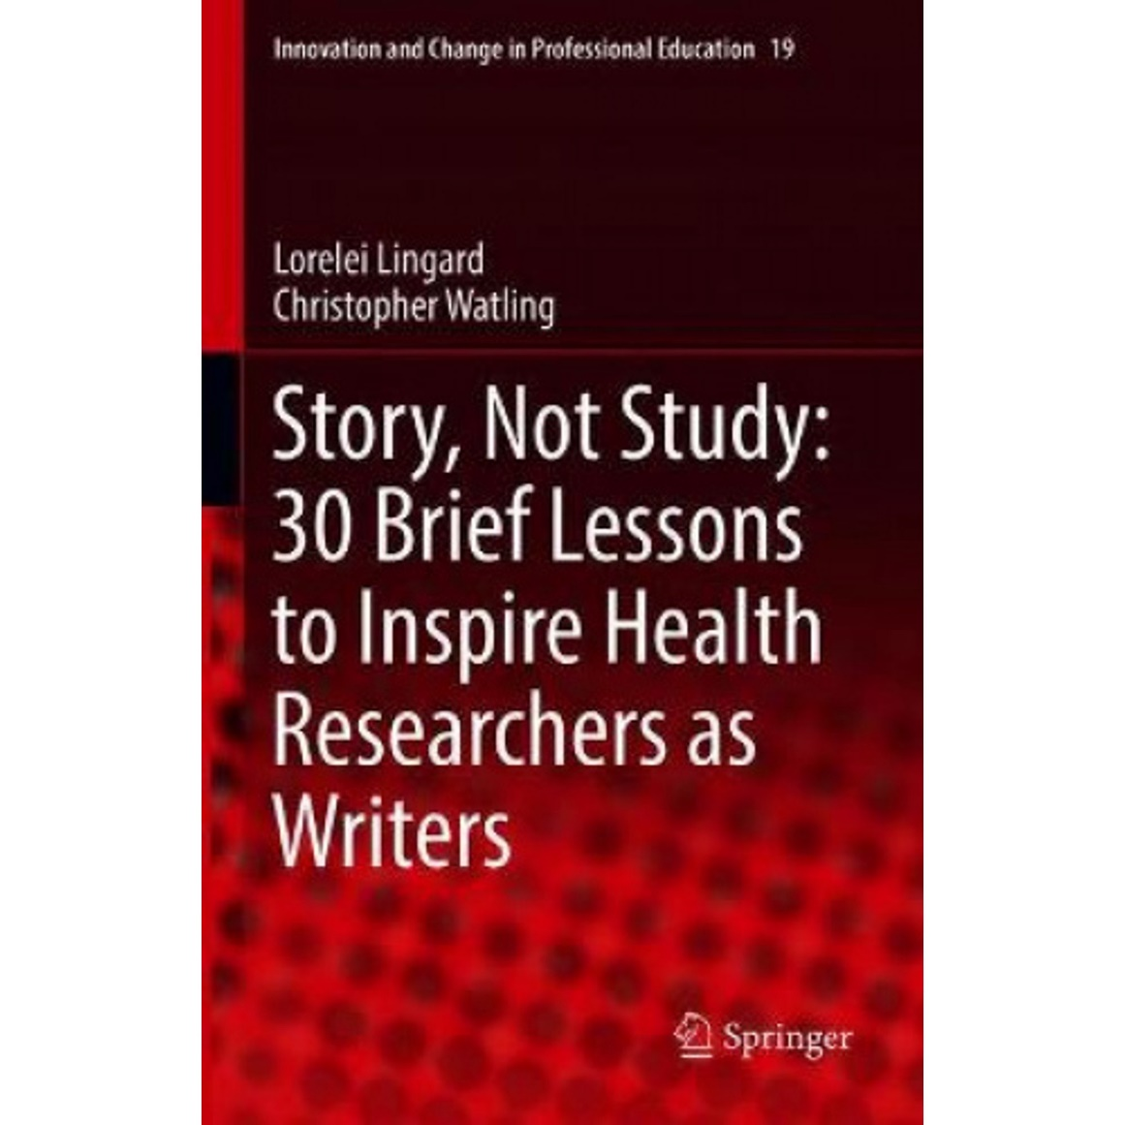

Today’s Readings
Lingard L. Joining a conversation: the problem/gap/hook heuristic. Perspect Med Educ 2015;4:252-253 (required reading)

Slide 3
Agenda
Introduce concept of Problem/Gap/Hook (PGH)
Group activity: Developing a problem-gap-hook
Exchange ideas with the bigger group

Slide 4
What makes academic writing effective?
Same thing that makes all writing effective:
Clear and easy to understand
Tailored to audience
Makes a sound argument
Effectively martials evidence to support argument

Slide 5
The Problem/Gap/Hook Heuristic (Lingard)
Versatile, adaptable to any genre of writing
Particularly effective for:
  Abstracts
  Manuscripts
  Grant applications
  Presentations

Slide 6
PGH Heuristic + Your Research
Research Question (responds to one part of “Gap”, doesn’t need to cover it all)

Slide 7
“Your audience will have evolving impressions of what constitutes a problem that matters in the world, and you need to have your finger on the pulse of this evolving social context as you do your literature review. Are you writing about a problem that is inarguably novel, one that is actively being worked on, or one that might be perceived by some readers to be already solved?”
(Lingard & Driessen)

Slide 8
The Problem
Not the same as the topic. Problem identifies one aspect of that topic.
Example 1: Mistreatment and abuse of health professional trainees is a topic. Problems might be:
  Lack of reporting
  We don’t know how to effectively remediate
  Some learners are targeted more often than others
  After decades of documenting this problem, nothing has changed

Slide 9
The Problem
Not the same as the topic. Problem identifies one aspect of that topic.
Example 2: Procedural skills training and assessment in pediatrics is a topic. Problems might be:
  Infrequent exposure to procedures in the clinical setting
  Number of assessments (e.g., EPA assessment) that residents need to complete is too many
  We don’t know what exactly to assess, as focus tends to be on technical skills (e.g., psychomotor)
  Pediatrics having unique challenges compared to other procedural specialties due to the variability in patient population

Slide 10
Group Activity
As a group, brainstorm and choose 1 PROBLEM that you will tackle the rest of the session.
We will come together and a volunteer from each group will be asked to share their identified problem.
  Explain why that is a problem
  Assume your classmates have basic familiarity with the topic, but do not know it intimately enough to identify the problem on their own OR understand why it’s such a big or such a severe problem

Slide 11
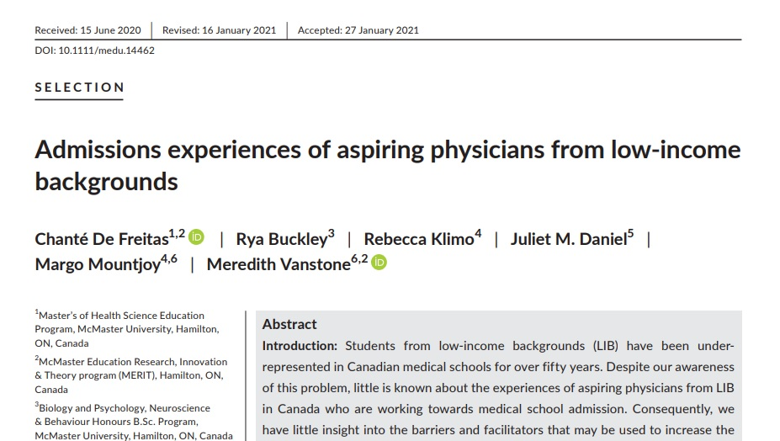
Example
De Freitas, C. et al (2021). Medical Education. 55(7):840-849

Slide 12
Example
Since the 1960s, it has been recognized that access to medical school differs by social class ¹. Despite awareness of this phenomenon and commitments by Canadian medical schools to produce physicians that meet the health needs of marginalized and vulnerable patients ²⁻⁴, the problem of underrepresentation of students from low-income backgrounds (LIB) in Canadian medical schools persists over 50 years later ⁵⁻⁷. In fact, the percentage of medical students from households earning less than $40,000 per year has decreased from 17.6% in 2001 to 7.5% in 2018⁷.
There is evidence that physicians from LIB are more likely to provide care to underserved populations than physicians from higher income backgrounds, especially when the LIB of the physician is considered alongside their race (Black, Hispanic) and/or sex (female) ⁸. Given the commitment to social accountability by Canadian medical schools to produce physicians that meet the health needs of all patients, the low representation of diverse medical personnel is detrimental to Canadian medical education and healthcare.
3 Problems:
To the applicants from LIB (unfair process and getting worse)
To patients (we are creating a medical workforce who does not adequately serve them)
To society (we are failing to meet our social accountability mandate)
From De Freitas, C. et al 2021

Slide 13
The Gap
The Gap (in current knowledge or thinking about the problem)
What do we know?
What is unanswered, or controversial, or contradictory, or unconsidered, or supported only by weak evidence
  Lots of potential gaps beyond “no one has studied this”

Slide 14
PGH Heuristic + Your Research
The gap will not be THE ENTIRE problem.
Research Question (responds to one part of “Gap”, doesn’t need to cover it all)

Slide 15
Group Activity
Re-group with your team. Brainstorm and choose 1-2 GAPS in current knowledge in relation your problem.
We will come together and a volunteer from each group will be asked to share their identified gap.
  Explain what the gap is.
  “This hasn’t yet been studied” is tempting to many, but it is NOT a convincing gap.
  Ask yourself:
    Why does it matter that this hasn’t been studied?
    What issue will new knowledge help ameliorate?

Slide 16
Example
Medical school admissions demonstrates a “social gradient,” with more affluent applicants being more likely to receive offers
of admission ¹⁶. This gradient is attributed to a number of causal pathways. Applicants from lower socioeconomic backgrounds
do not apply to medical school as much as their wealthier peers ¹⁷⁻¹⁹, experience lower academic achievement ²⁰,
and have a smaller presence in the applicant pool than their wealthier peers ²⁰⁻²². Applicants from LIB are also less likely to
gain interview invitations ²³ and have lower odds of acceptance ^{21, 24}.
[Following paragraphs describe income disparities in applicant performance on formal admissions assessment tests, as well as less
standardized aspects of the admissions process. This evidence also points to conflicting results in the literature that leave questions
about whether admissions tests are the determining factor, or disparities occur much earlier than the medical school application
process]
Gap:
While there is copious documentation of disparity between the medical trainees and the general population, this is a complicated problem related to inequalities in opportunity throughout the educational trajectory.
Adapted from De Freitas, C. et al 2021

Slide 17
The Hook
Readers must believe that filling the gap will change something.
Must see the gap as something worth filling.
The hook is a way of establishing BOTH relevance AND significance of the gap.

Slide 18
Group Activity
Re-group with your team. Brainstorm the hook- why does this matter?
We will come together and a volunteer from each group will bring everything together and be asked to share their Problem-Gap-Hook.

Slide 19
Example
Hook:
Stop focusing on admissions assessment tests- disparities begin way before that. If we want to promote equity in medical school admissions, we need to understand the whole pre-med trajectory.
Assessments of merit on the basis of grade point average, standardized test scores, and admissions assessment tests appear to be fair, with the highest performing students awarded an admission offer. However, not every applicant has the same access to opportunities to demonstrate or enhance their performance. For example, students who must hold paid employment to afford their rent and tuition do not have the same opportunity for dedicated test preparation. Students from LIB may also have fewer opportunities to acquire life experiences valued by medical schools ²² and fewer resources to access the potential benefits of standardized test preparation ²⁹. The individualistic assessments of merit embedded in the medical school admissions process fail to consider the social, economic, and political contexts of each applicant’s performance ³¹. In other words, there are systemic forces outside individual control that influence an applicant’s performance and ranking in their medical school application.
From De Freitas, C. et al 2021

Slide 20
Example
Topic: Procedural skills training and assessment in pediatrics
Problem: Infrequent exposure to procedures in the clinical setting, leading to lack of trainee competence and achievement of assessment requirements.
Gap: Literature suggests that there are certain procedures that pediatrics residents are expected to be competent at, but currently are not. Exposure beyond the clinical setting usually includes in-person simulations, but these are resource-intensive (financial, human, space). Hence, programs are exploring other ways of creating opportunities for trainees to be exposed to pediatric procedural skills (e.g., virtual reality), in order to gain competence and achieve assessment requirements.
Hook: Procedural skills are an important part of patient care, and if residents are not competent by the end of training, then we are graduating residents who are not ready to perform procedures in practice, which could lead to issues related to patient safety. Also, residents cannot graduate without the necessary number of assessments.
Lets stop worrying about clinical exposure alone or planning resource intensive and infrequent in-person simulations, rather explore the use virtual simulations as an adjunct to support training and assessments.

Slide 21
Example: THEN…the research question or objectives
Objective: To explore perceptions regarding the role of immersive virtual reality simulation to support trainees in (a) gaining competence and (b) achieving EPA assessment requirements
Research Questions:
  Based on faculty experience going through an IVR scenario, What are the similarities and differences between the IVR and clinical environments, in terms of functional and structural fidelity?
  What is the potential role of IVR for assessment purposes to support residents achieve assessment requirements set by the Royal College?

Slide 22
PGH Heuristic + Your Research
Research Question (responds to one part of “Gap”, doesn’t need to cover it all)

Slide 23
Thank you
Problem-Gap-Hook: Effective Scholarly Writing
Instructors: Drs Elif Bilgic and Anita Acai; Acknowledgment: Dr Meredith Vanstone

