Slide 1


Successful Grant Review
Instructors: Anita Acai and Elif Bilgic
Slide Credits: Dr. Meredith Vanstone

Slide 2

AGENDA
What’s a grant?​
How are they awarded?​
What is the review process like and how can you prepare for success?​
Later in the Week:​
Identifying, managing, budgeting for grants (logistics)

Slide 3

A grant is funding to conduct scholarship (research, implementation, evaluation)
It is typically awarded through a competitive process and involves a contract that specifies what you (grant-holder) will do, how much this will cost, what eligible expenses are, what you must deliver back to the funder, and on what timeline.
Grants tend to be for research, not program implementation (unless the program is an intervention, and you are researching effectiveness)

Slide 4

Other things that are kind of (but not really) like grants:
Scholarships
Stipends
Programmatic funding
Requests for Proposals
Consulting contracts
These can also fund your education scholarship!

Slide 5
COMMON ELEMENTS
Persuasive writing!​
Demonstrate a problem that exists ​
Convince the funder to care about that problem​
Explain why the problem hasn’t yet been solved​
Introduce a potential solution​
Assure the funder about feasibility​
Situate yourself as the person/team best situated to do this

Slide 6







FROM IDEAS TO GRANT SUBMISSION
Submit to funding agency
Funding opportunity
Idea
Write
Revise
Internal approvals
Assemble team, supporting documents, letters

Slide 7






FROM SUBMISSION TO IMPLEMENTATION
Open account
REB approval
Hire staff
Start research!
Funded, contract with institution, transfer of funds
Admin check of requirements
Reviewer selection
Committee discussion
Not funded, receive feedback, revise, submit next round
Individual reviews assembled

Slide 8
STEP 1: IDENTIFY THE PROJECT
Is this research? Is it educational development? Is it quality improvement? Is it testing and refining an intervention? Does it involve evaluation?
Which aspects of this project are flexible, which are rigid?
  E.g., educational intervention is set, but could be applied in any clinical setting

Slide 9

Which pieces can you swap in / out to construct a compelling project?
E.g., disease or profession, international collaborators, evaluation component

Slide 10
IDENTIFY THE FUNDING SOURCE
Internal
  Programs, departments, specific calls for proposals
External
  So many options! TBC
Education-specific
  HCP colleges have education grants, so do PSI, Stemmler, Spencer Foundations
Profession-specific
  CFPC, AOM, PSI offer funding to members of their organization for research that will further the profession
Disease-specific
  Charities, foundations

Slide 11
HOW DO YOU IDENTIFY FUNDING SOURCES?
Many will recur year after year, ask around
Internal groups, mailing lists
External funding databases
  Pivot RP (subscription-based)
  https://merit.healthsci.mcmaster.ca/wp-content/uploads/2022/07/hpe-funding-award-opportunities_uplload.pdf
  https://www.mcgill.ca/medhealthsci-facdev/links/funding
  https://www.kumc.edu/school-of-medicine/office-of-medical-education/academy-of-medical-educators/resources/funding-sources-for-medical-education-research.html

Slide 12
A NOTE ABOUT THE TRI-COUNCIL
Canadian Institutes of Health Research (CIHR)
Natural Science & Engineering (NSERC)
Social Science & Humanities (SSHRC)

Slide 13
MAKE SURE YOU UNDERSTAND THE OPPORTUNITY
Timelines
Priority areas
  For this call
  For the organization
Requirements (Does the PI need to be a member of the group?)
Application specifics
  Letters of support, eligible budget items, specific pieces of information

Slide 14

How long does it take to write a grant?
How much do you already have assembled?
Are your collaborators going to be helpful in grant preparation?
Is the idea solid, or are you still developing it?
Do you have relationships with the groups you will need letters of support from?
What is the internal review/submission process like?
In general, think in months when you plan a grant.

Slide 15

Internal approval process, what?
Notes:
They are going to hold the funds and administer the money, They will want to sign off.

Slide 16
ADJUDICATION – HOW TO PREPARE FOR SUCCESSFUL REVIEWS
Prepare for reviewers who:
  Know your topic very well, but methods not at all (and reverse)
  May have competing work or professional interests
Prepare for committee members who:
  Work in the same large field (e.g., Health Policy & Systems Management committee at CIHR) but are not familiar with topic or methods
  Listening to a lot of excellent grant ideas

Slide 17

Imagine your reviewer…
Two days of reviewing applications
Will be expert in some aspects, but not all
May be a methodological mismatch
May work in an international context
Jargon often incomprehensible
Other work is piling up
Having to reduce complexity of assessment to one number

Slide 18
SUMMARY OF PROPOSAL
Your “first impression”
Great chance to get the argument down clearly:
  What is the topic?
  What problem will you address?
  What knowledge will you generate?
  What impacts will this new knowledge have?

Slide 19

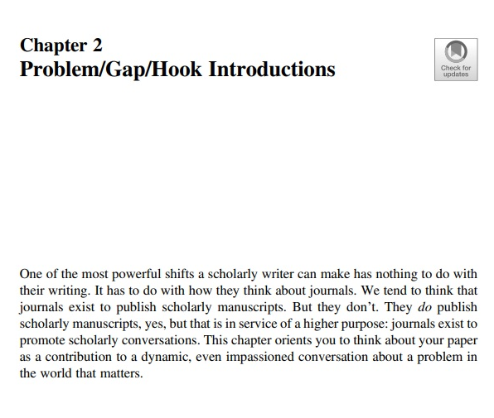

Slide 20
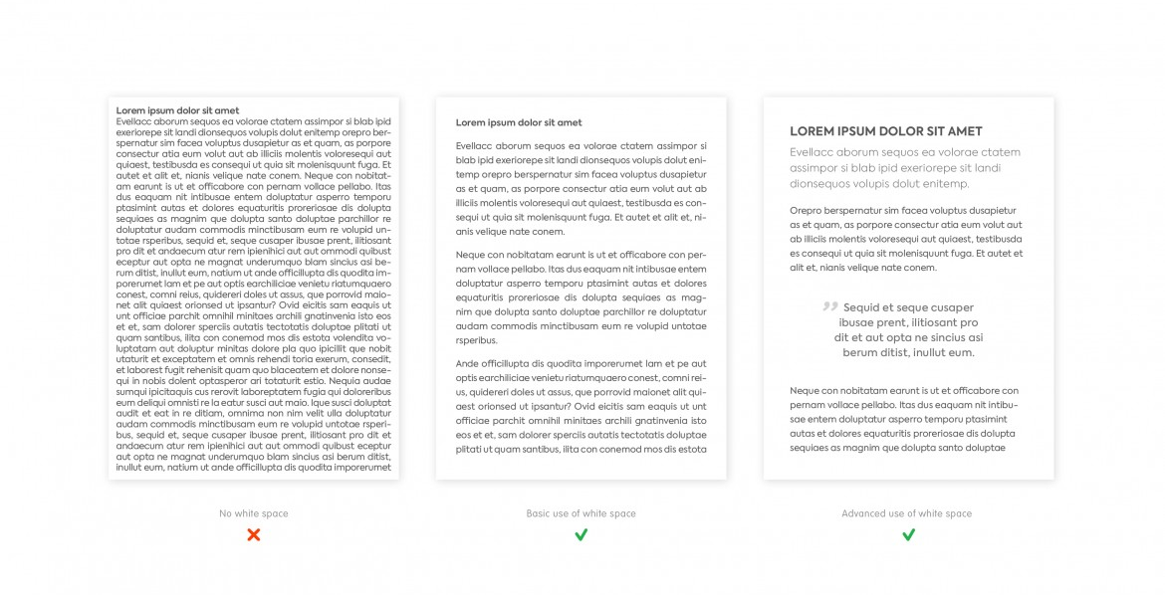

Slide 21
PAY CLOSE ATTENTION TO ADJUDICATION CRITERIA
Typically, available from funder’s website
Reviewers will be very familiar; will adhere closely
Write to the criterial; use the same phrases or headings to help reviewers

Slide 22
EXAMPLE: CIHR SCHOLARSHIP
  Academic Excellence (50%)
    Academic record (transcripts)
    Scholarships and awards
    Duration of previous studies (over time?)
    Course load
    Relative standing (if available)
  Research Potential (30%)
    Quality and originality of contributions
    Relevance of work experience and academic training to field of proposed research
    Significance, feasibility, merit of proposed research
    Critical thinking, application, initiative, autonomy, independence
    Research experience and achievements (publications, presentations, jobs)
  Personal characteristics and interpersonal skills (20%)
    Work experience
    Leadership
    Project management
    Ability to communicate scientific concepts
    Involvement in academic life, volunteerism, community outreach

Slide 23

TIPS – ARRANGE A FRIENDLY PEER REVIEW
Reviewers are likely to be experts in the broader field, but not necessarily in the exact topic or methods
Ask a colleague who fits a similar profile for a friendly review. What makes sense? What is unclear? What problems do they see?

Slide 24
TIPS – CHALLENGES AND MITIGATION SECTION
What challenges might you encounter in this research (or might reviewers anticipate you will encounter?)
Name each, with mitigation strategies to demonstrate feasibility

Slide 25

TEAM
Each person should have a specific role:
Methodological
Topic
Knowledge user / decision-maker
Access to patient / learner populations
Mentorship on project management
Trainee or early-career researcher you will mentor
Clinical, patient, community perspective
Beware the gigantic team with undefined or overlapping roles…

Slide 26
GRANT REVIEW ACTIVITY PROMPTS
What is this grant about?
What are the strengths of the applications?
Weaknesses?
Do you think this grant was funded?
If you were a reviewer, would you fund this grant?

Slide 27
Thank you!

